Slide 1
TIME | ACTIVITY | PLACE
First Day
09:30-10:00 | Centralized departure at Zhuhai, Guests by car can go to Kaipingtangkou Town by themselves | designated point
10:00-12:00 | Departing for Kaiping Tangkou, the journey takes approximately 2 hours."
12:00-13:30 | "Having a meal at the Qiaojia Village Farmhouse in Kaiping Tangkou Town | Qiaojia Village Farmhouse
13:30-14:00 | Take a car ride to Kaiping Chikan Ancient Town. Self-driving guests can proceed to the destination on their own. | Kaiping Chikan Ancient Town
14:00-16:00 | visit Kaiping Chikan Ancient Town.
16:00-17:00 | Take a car ride to Enping Quanlin Golden Town and stay at Enping Quanlin Hotel Self-driving guests can proceed to the destination on their own. | Enping Quanlin Hotel
18:00-21:00 | "Enping specialty cuisine + self-service barbecue music dinner." | Outdoor restaurant at Enping Quanlin Hotel.
21:00-24:00 | Free activities
18:00-20:00 | Return the journey

Slide 2
TIME | ACTIVITY | PLACE
Second Day
08:30-09:30 | hotel buffet breakfast | restaurant at Enping Quanlin Hotel.
10:00-11:30 | professional racing knowledge seminar | Guangdong Hippo Racecourse
11:30-17:30 | Enjoy karting, motorcycles, and all-terrain vehicles (UTV or ATV)". | Guangdong Hippo Racecourse
18:00-20:00 | Return the journey
 | End of a pleasant journey!

Slide 3
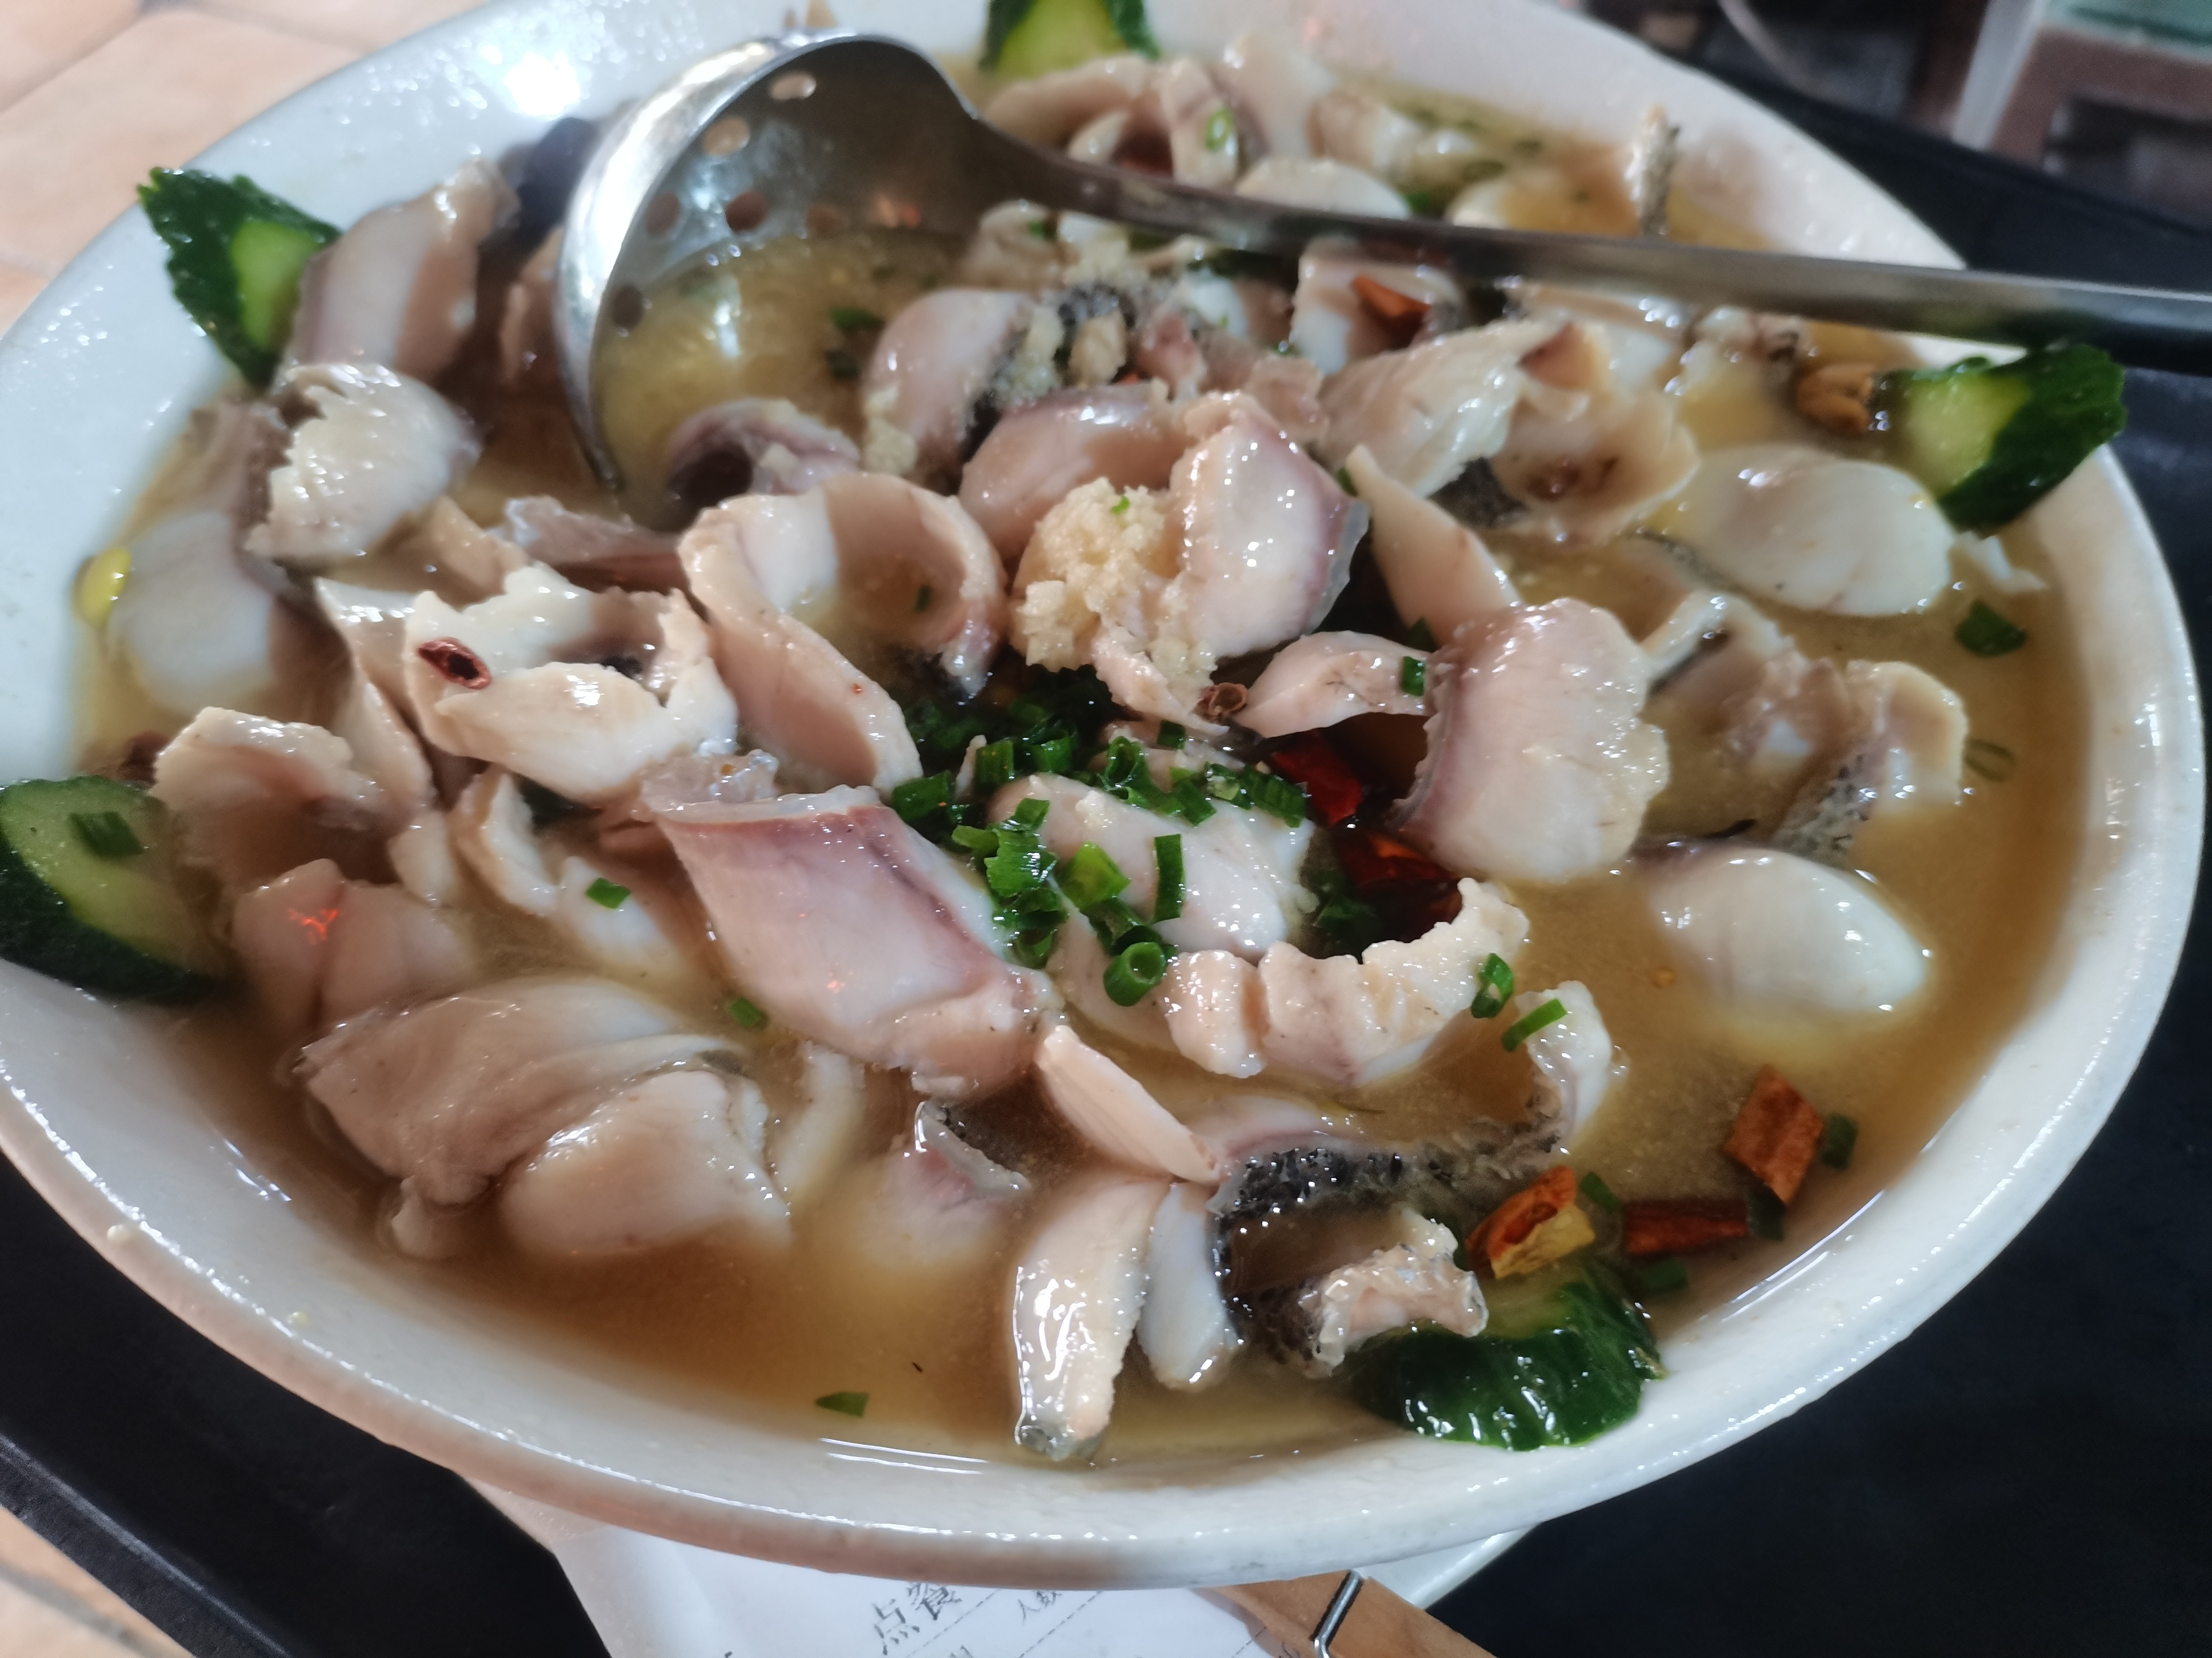
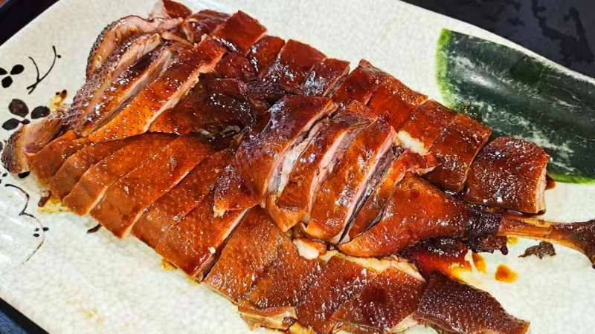
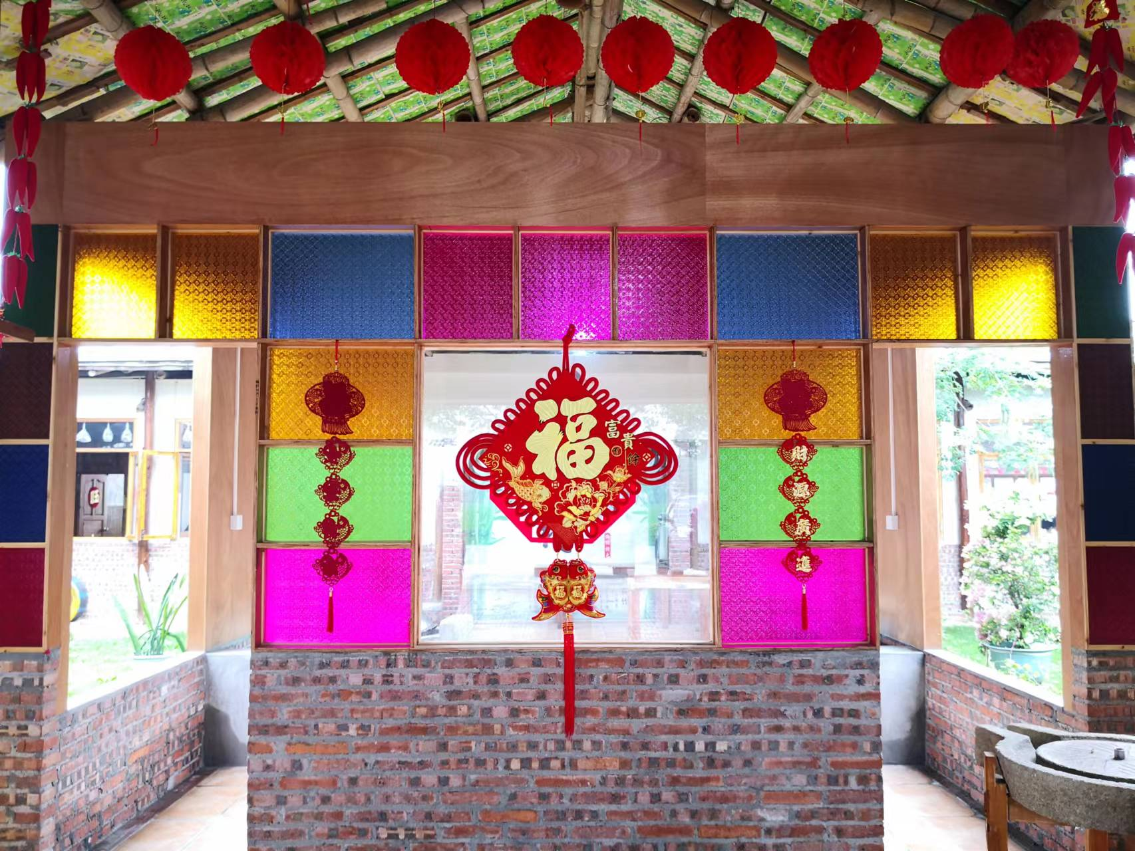
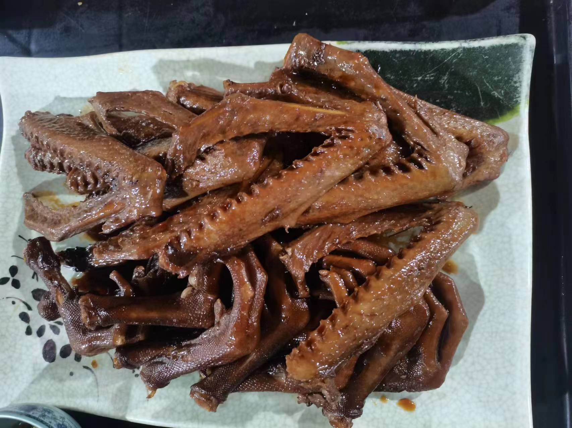
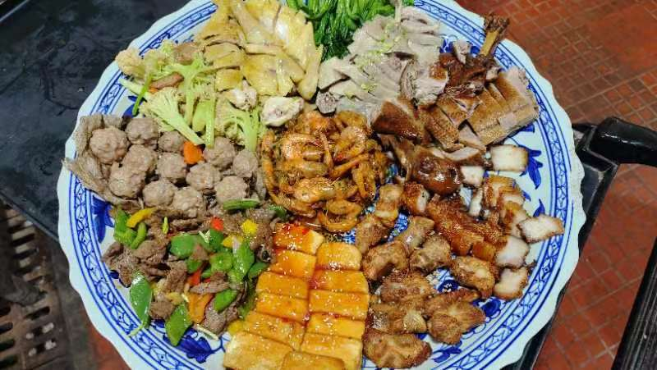
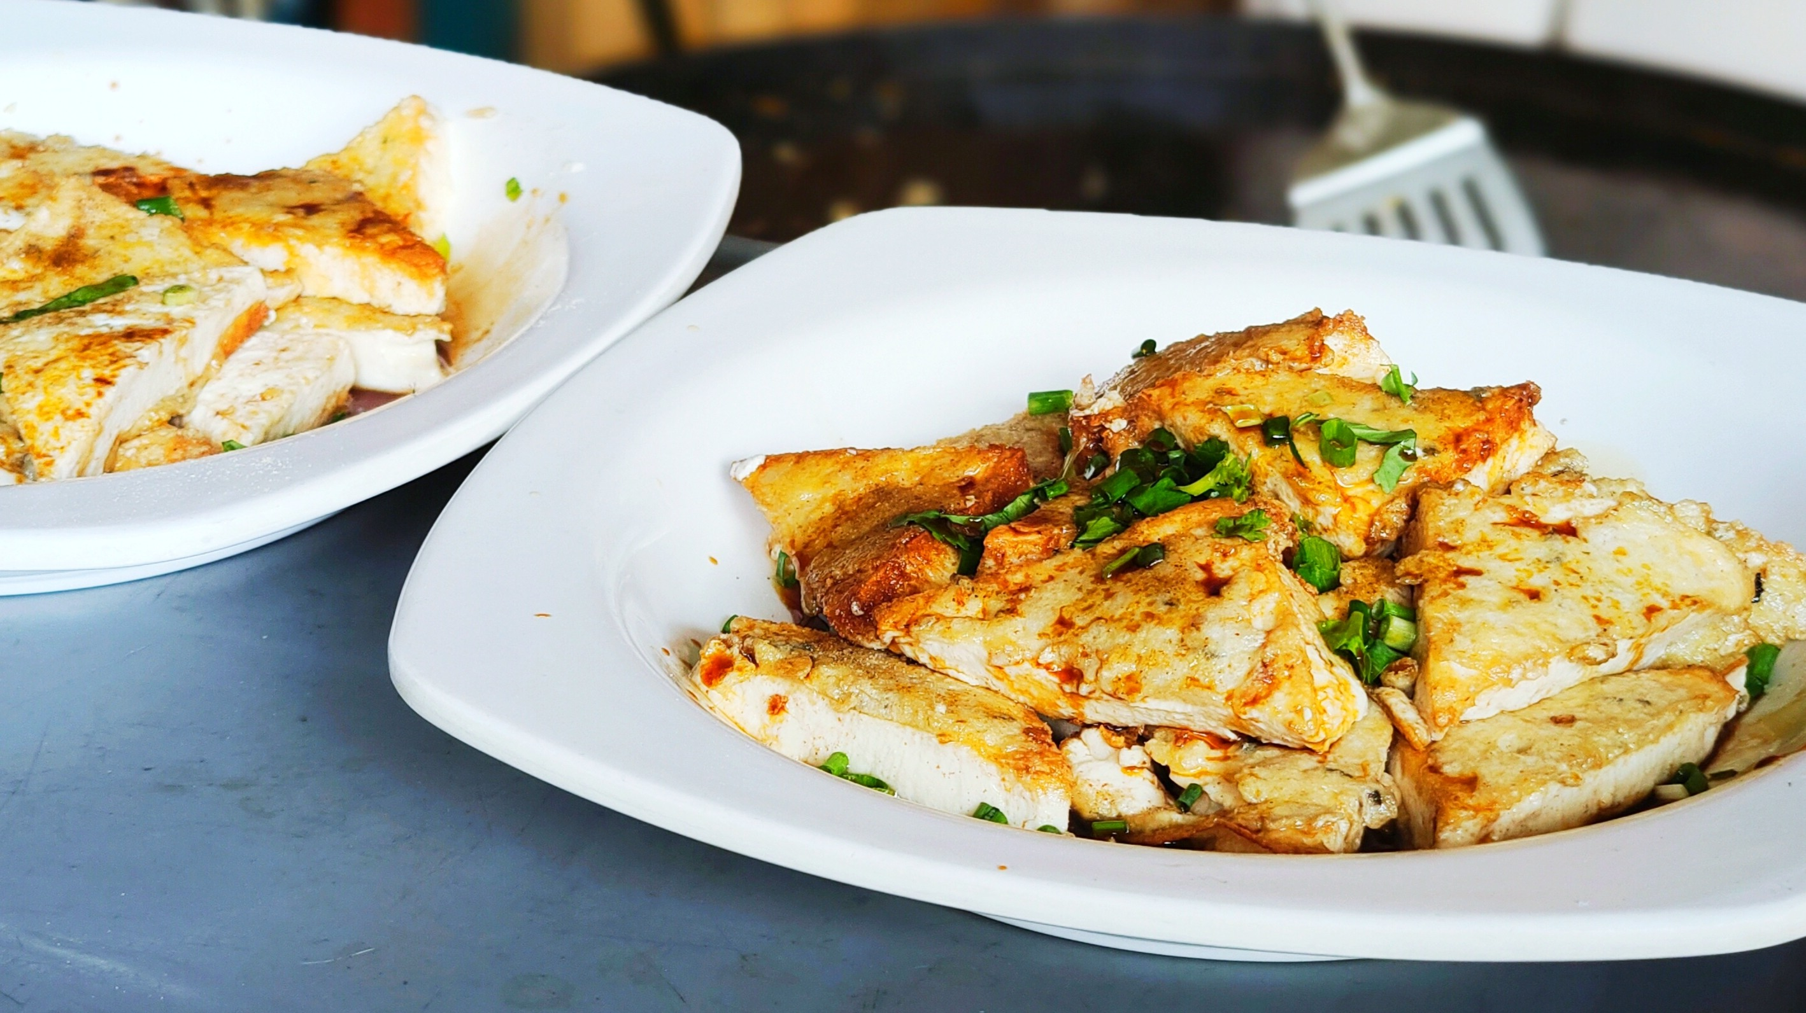
Introduction of the Northbound Overseas Chinese Hometown Tour' Itinerary
The First Date
at 9:30am, gather at the parking lot of Hong Kong-Zhuhai-Macao Bridge Port and take an air-conditioned coach to the famous overseas Chinese hometown, Kaiping. Enjoy a special lunch at the Qiaojia Village Farmhouse in Tangkou Town, savoring the renowned local delicacies of Magang Goose and handmade rice noodles.
specialty lunch

Slide 4
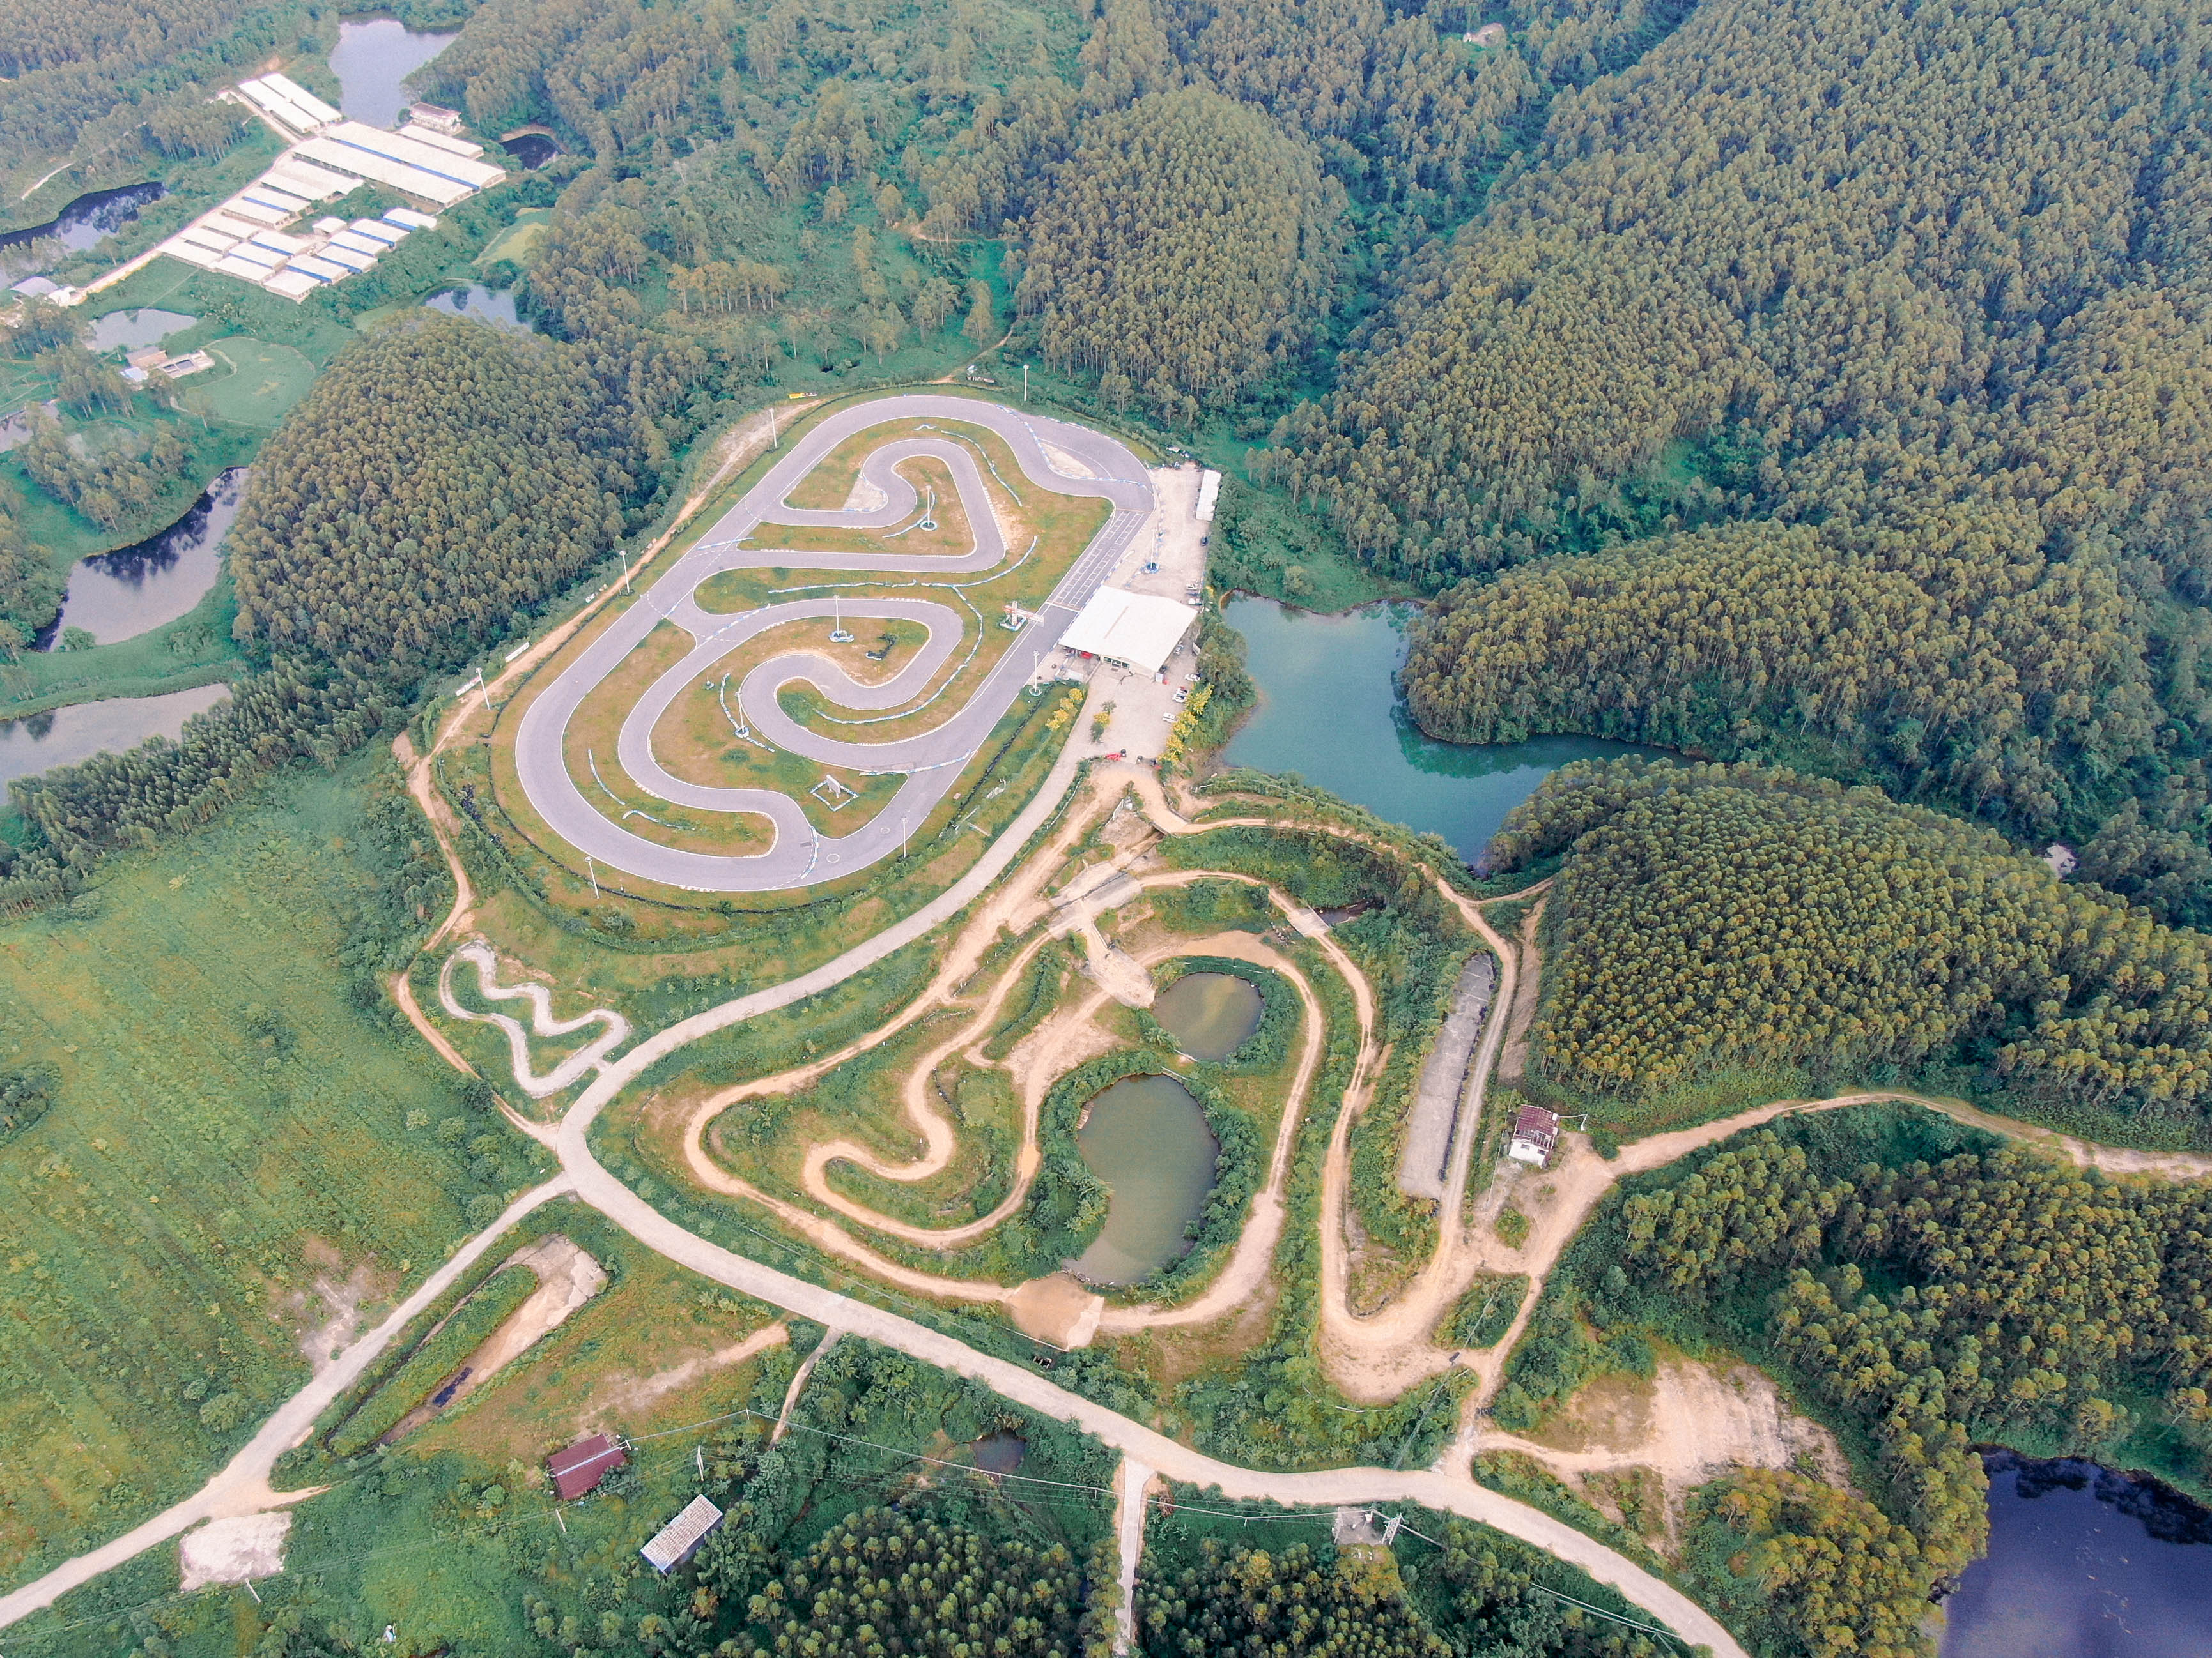
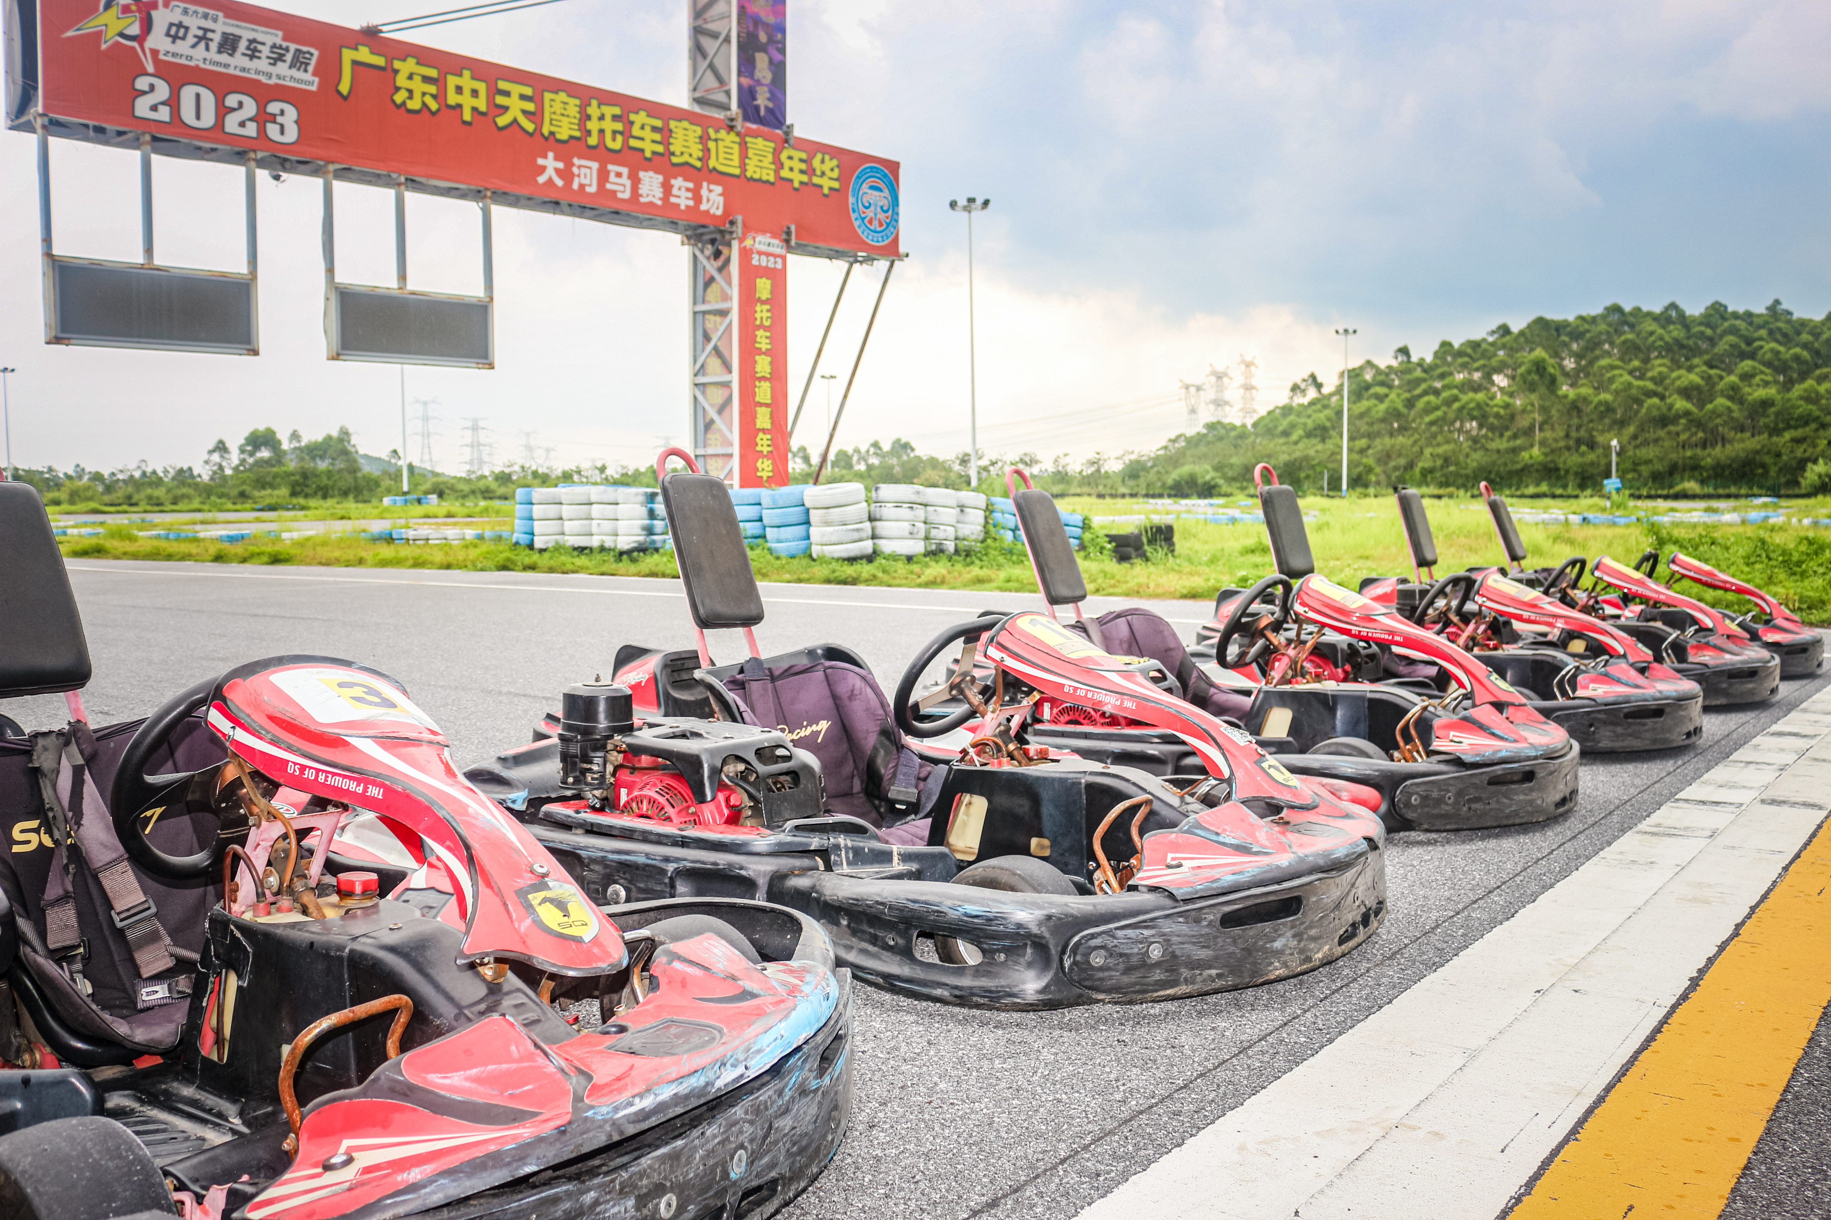
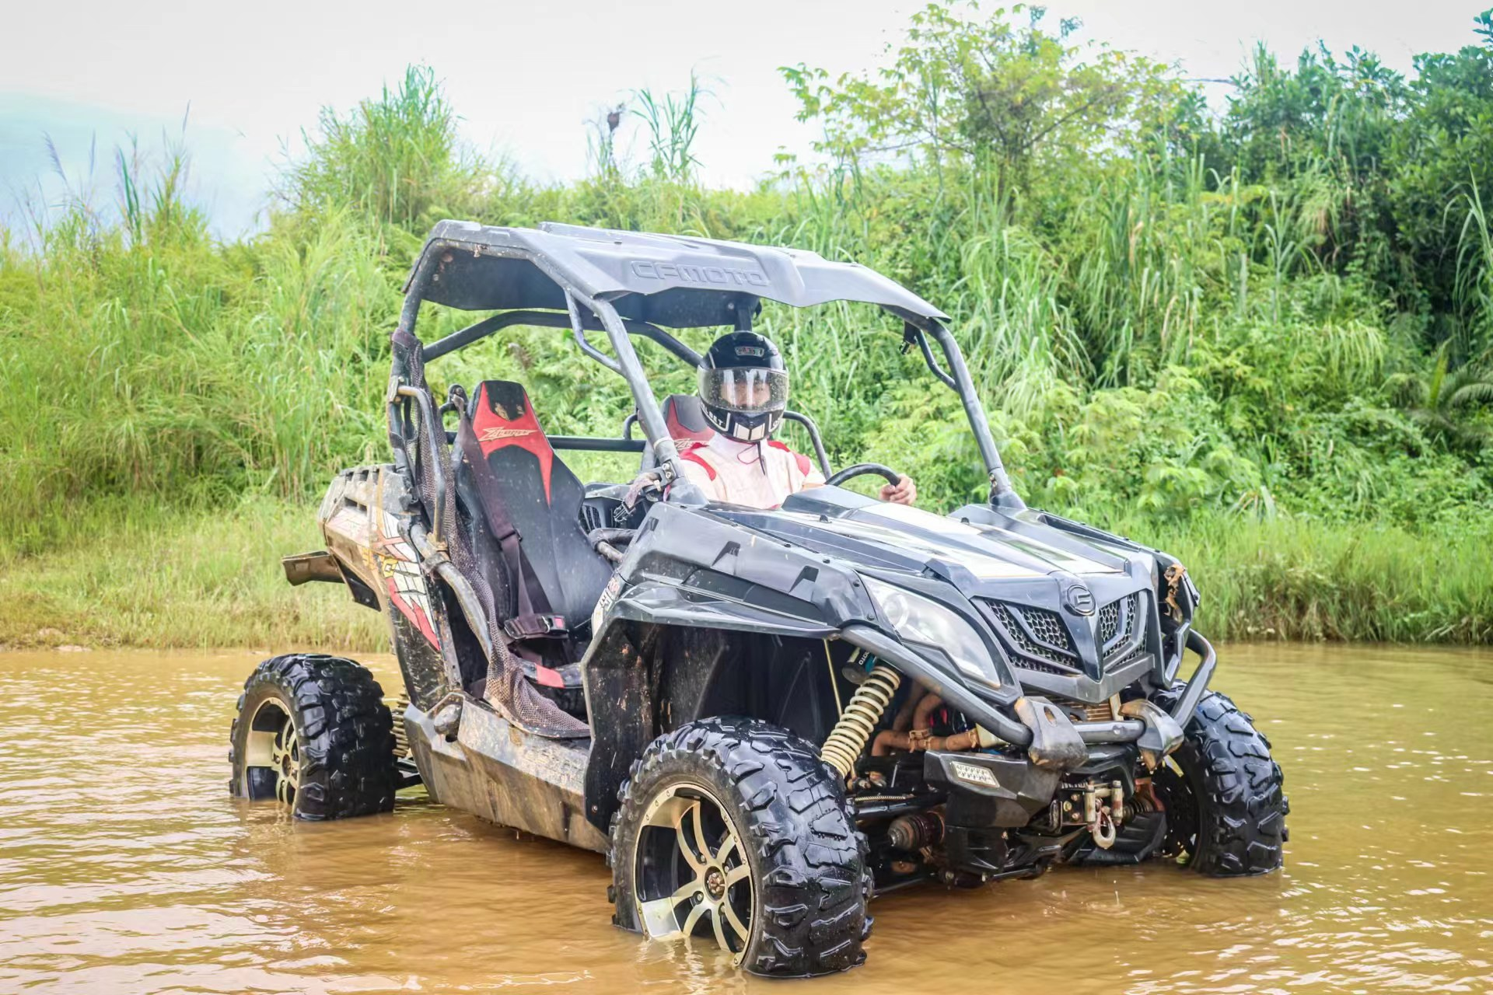
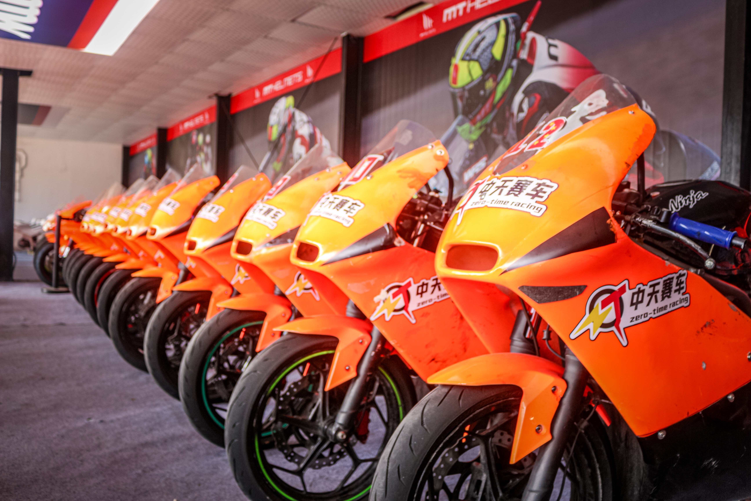
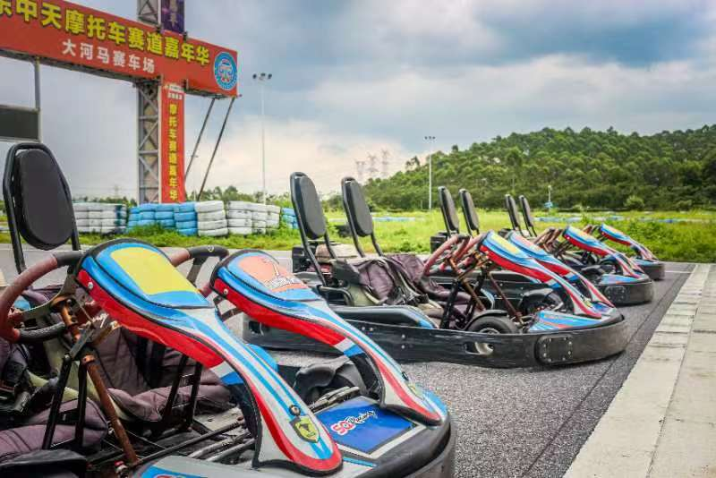
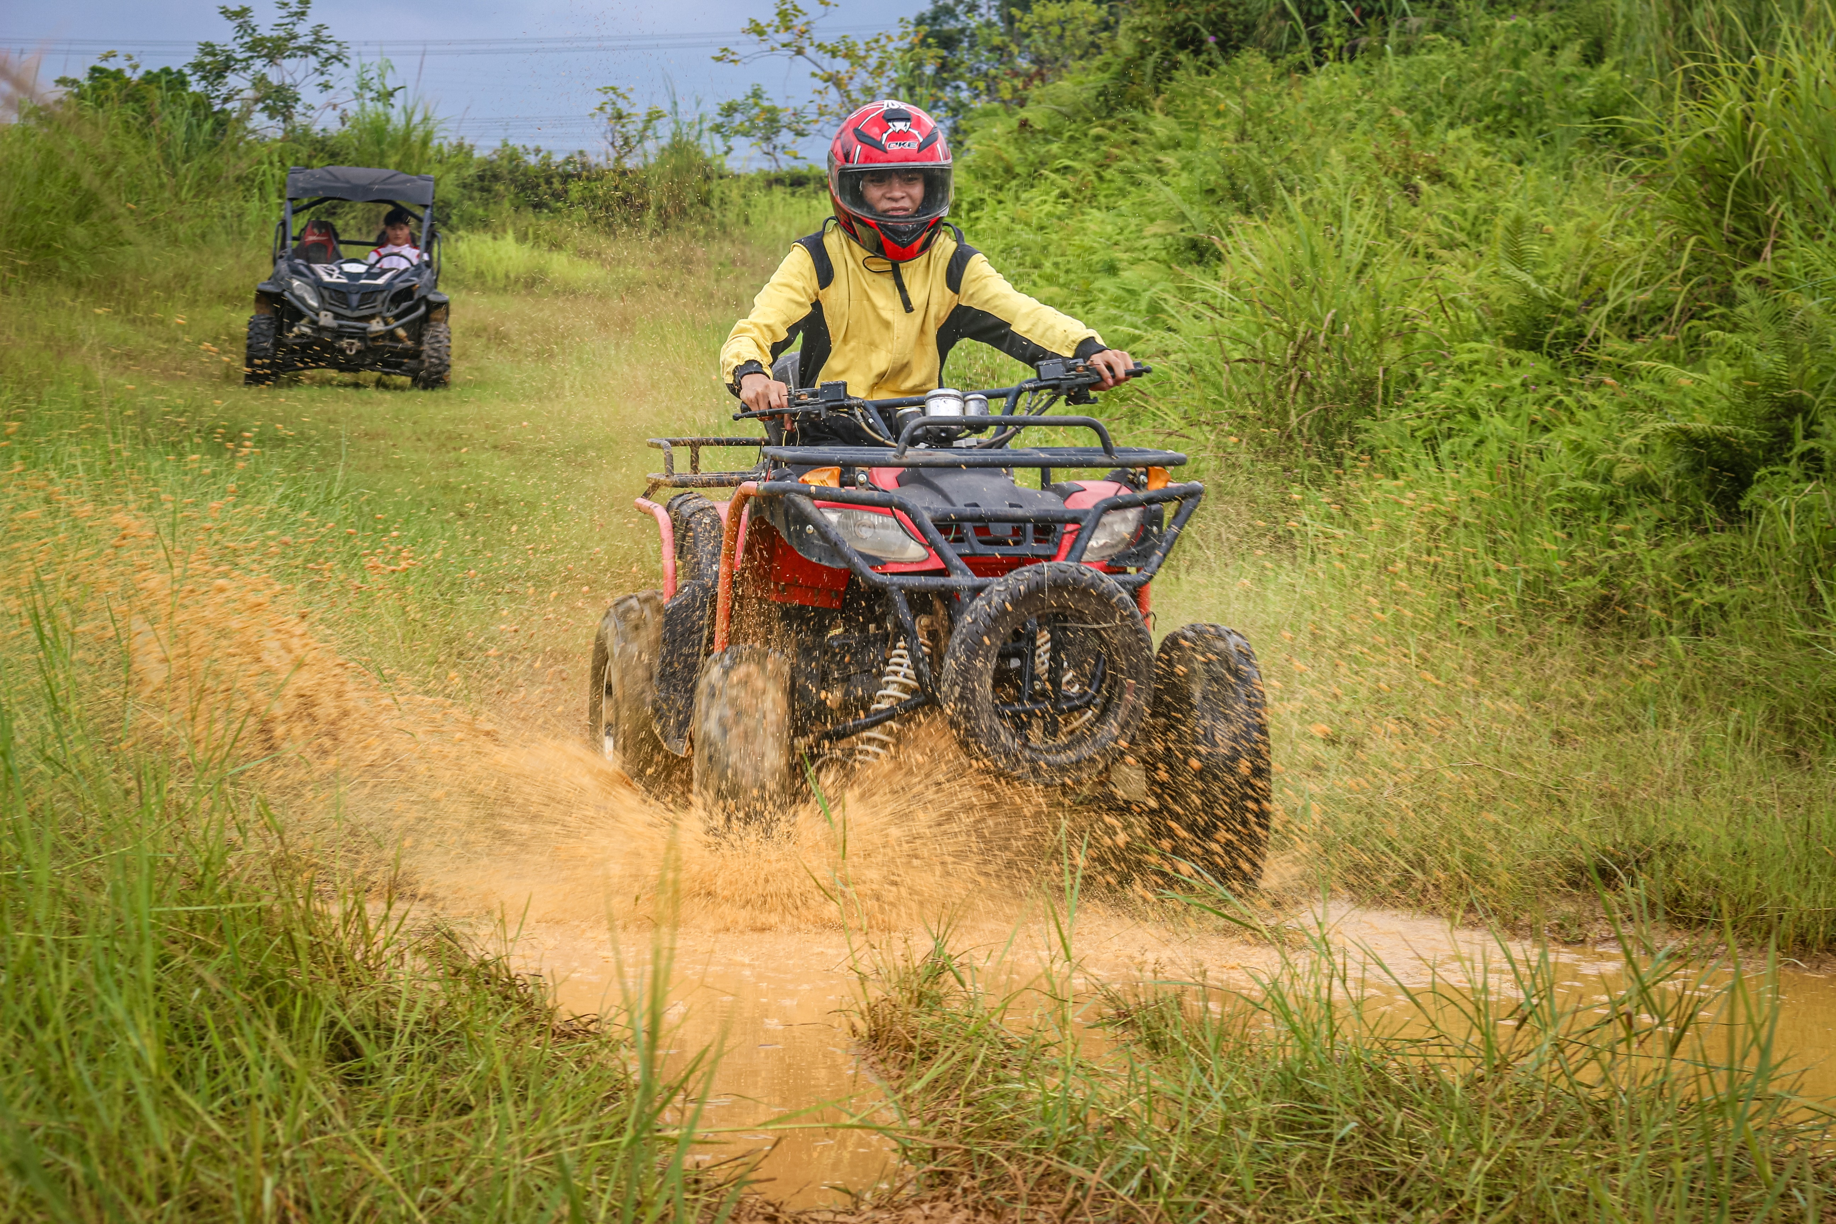
Introduction of the Northbound Overseas Chinese Hometown Tour' Itinerary
The Second Day At 8:30am, proceed to the Hotel Yumi Zhixiang Restaurant for breakfast on your own. At 9:30am, gather and head to the Hippo Racecourse for a professional racing knowledge seminar and track experience. Participants have the option to change into the professional racing suits provided by the racecourse (or bring their own). Enjoy unlimited sessions of karting on a national A-level track that stretches 1200 meters in length, or take control of an all-terrain vehicle (ATV or UTV) to navigate through simulated outdoor environments with soft sand roads, water ponds, mud pits, narrow paths, and multiple sharp turns. Participants under the age of 65, in good health, and with driving experience can also try out 150cc or 250cc motorcycles (4 parts). Additionally, enjoy a simple lunch and afternoon tea at the racecourse.
Drivinng Experience

Slide 5
Introduction of the Northbound Overseas Chinese Hometown Tour' Itinerary
Price: HKD 5000 per person (min. 25 pax to start the tour）
The cost includes:
Air-conditioned coach transportation throughout the trip.
Double occupancy in a one-bedroom suite at Quanlin Hotel, Yuehu Bay (Single occupancy requires an additional room supplement of CNY 300).
Three main meals throughout the trip (Kaiping specialty lunch, Enping specialty cuisine + barbecue dinner, and a simple lunch at the racecourse), as well as one breakfast and one afternoon tea.
Tour guide: Professional tour guide service.
Admission tickets: Chikan Ancient Town main entrance ticket, Najinggu Rice Granary ticket, and boat ride.
Venue fee at Hippo Racecourse.
Professional racing knowledge seminar.
Unlimited enjoyment of karting and all-terrain vehicles (UTV or ATV) at Hippo Racecourse, as well as motorcycles (150cc or 250cc) for participants under 65 years old, in good health, and with driving experience.

Slide 6
Introduction of the Northbound Overseas Chinese Hometown Tour' Itinerary
Professional racing equipment (can be brought by participants), professional maintenance technician service, and gasoline.
Mineral water and soft drinks in the lounge area.
Live streaming of photos and video coverage throughout the trip.
The cost does not include:
Any expenses not mentioned in the "cost includes" section.
Motorcycle insurance for accidental damages (CNY 300 per motorcycle). With this insurance, no compensation is needed for damage caused to the motorcycle on the day of purchase (except for non-motorcycle-related issues, and no vehicle exchange is possible).

